Slide 1
National Churchill Museum

Slide 2
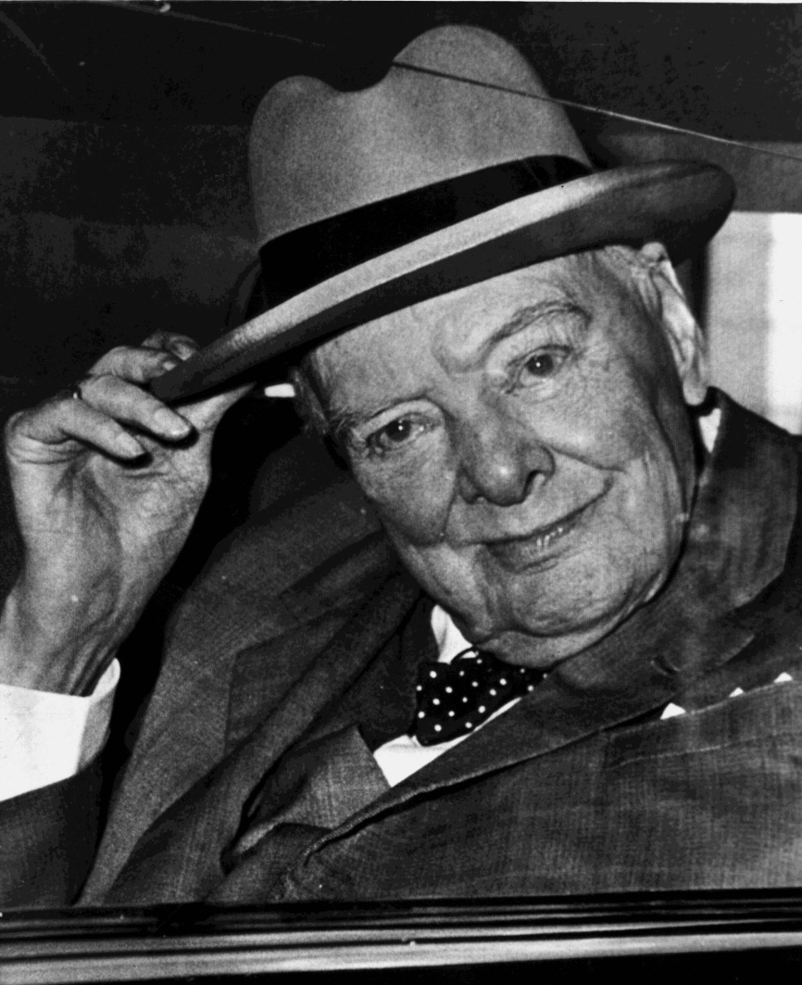
Winston Churchill Jeopardy
Click on the animation in the lower right hand corner to advance to the first slide.
You can choose a dollar amount and the category of your choice.
Click on the animation to return to the main slide.
To view the answer to the question, click anywhere on the screen except on the animation because as mentioned before it will return you to the main slide.

Slide 3
Museum Exhibits | Wit and Wisdom | Leadership | Life and Times | Fun Facts
$100 | $100 | $100 | $100 | $100
$200 | $200 | $200 | $200 | $200
$300 | $300 | $300 | $300 | $300
$400 | $400 | $400 | $400 | $400
$500 | $500 | $500 | $500 | $500

Slide 4
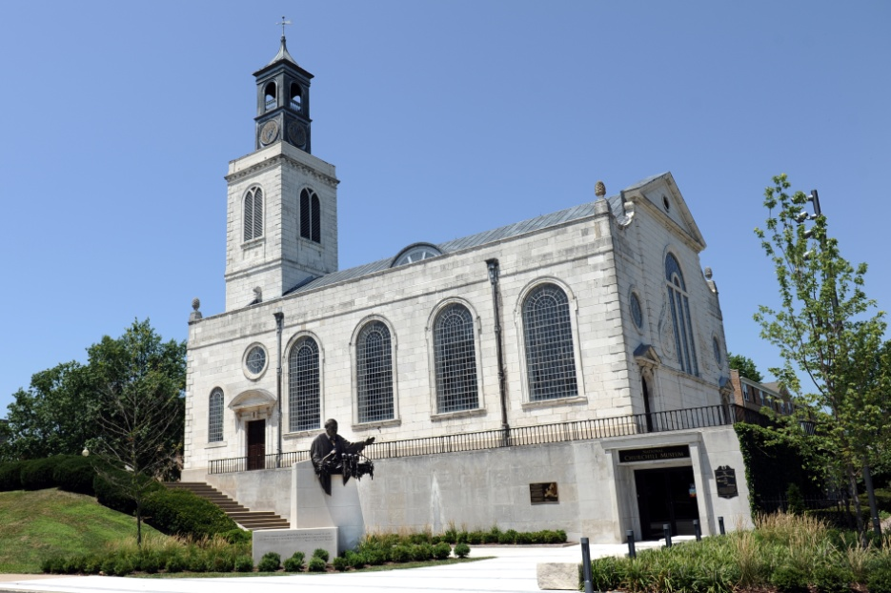
Museum Exhibits for $100
From 1965 to 1967, this church was deconstructed into 7000 stones, shipped to Fulton, MO, and rebuilt as a memorial of Winston Churchill’s visit to Westminster College.
What is the Church of St. Mary the Virgin, Aldermanbury?

Slide 5
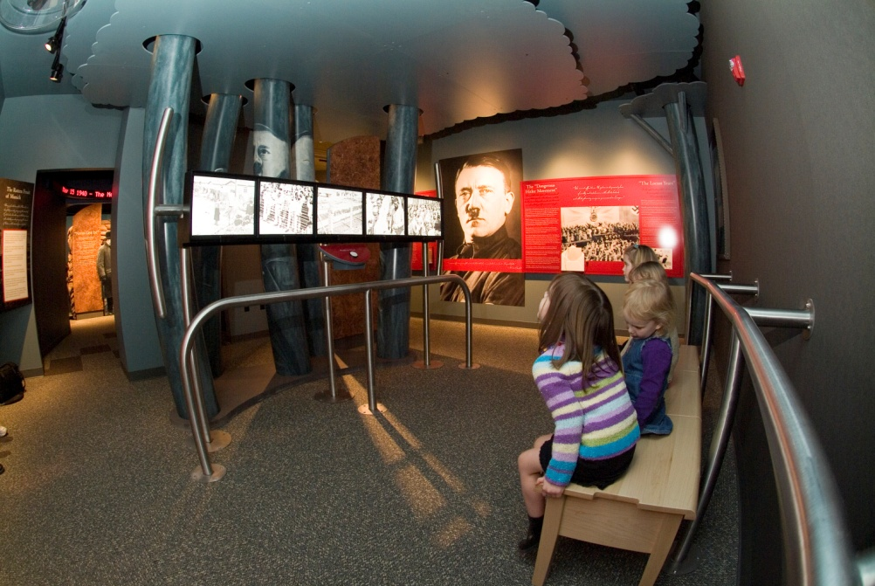
Museum Exhibits for $200
In ‘The Gathering Storm’ exhibit, Churchill refers to this political leader as “…a maniac of ferocious genius of the most virulent hatred that has ever corroded the human breast…”
Who is Adolf Hitler?

Slide 6
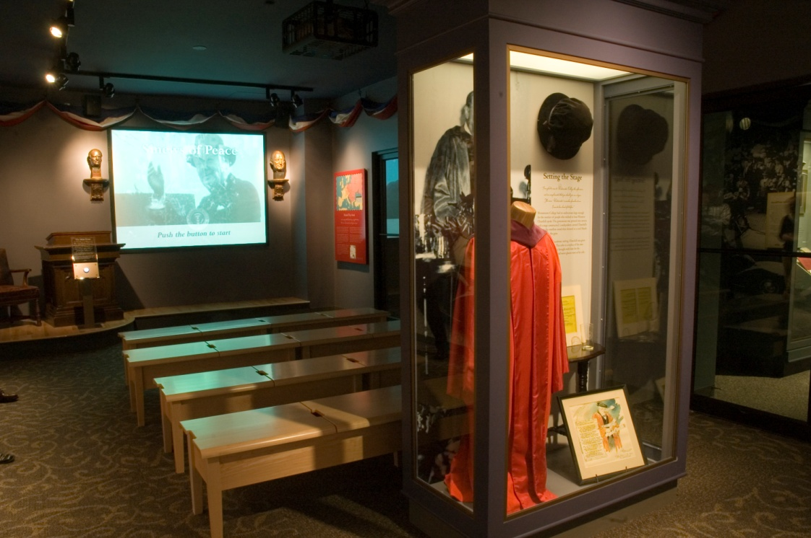
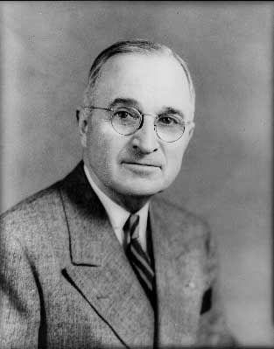
Museum Exhibits for $300
In ‘The Sinews of Peace’ exhibit, what world leader influenced Churchill’s visit to Westminster College?
Who is Harry S. Truman?

Slide 7
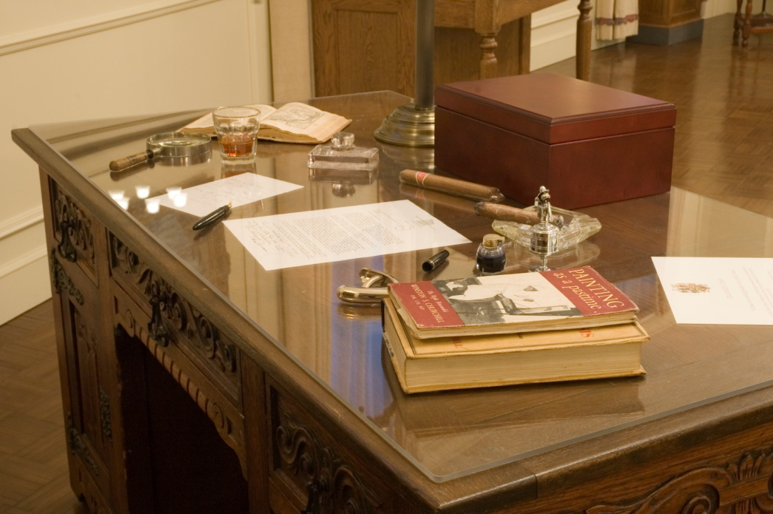
Museum Exhibits for $400
These two items made regular appearances on Churchill’s desk.
What are the cigar and whiskey?

Slide 8
Museum Exhibits for $500
Churchill’s granddaughter, Edwina Sandys, created this sculpture as a representation or symbol of the end of the Cold War. It stands next to the Churchill Museum.
What is “Breakthrough”? (made of 8 sections of the Berlin Wall)

Slide 9
Wit and Wisdom for $100
Winston Churchill wrote to his brother on November 15, 1895:
“This is a very great country my dear Jack”.
Which country was he talking about?
What is America??

Slide 10
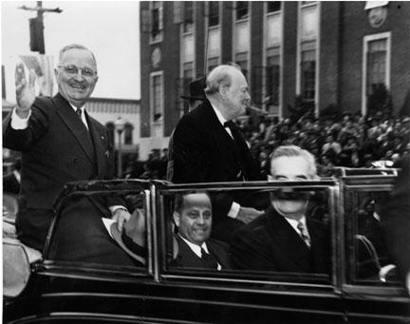
Wit and Wisdom for $200
In what year and in what place did Churchill deliver his famous ‘Sinews of Peace’ speech?
What is Fulton, Mo in 1946??
Bonus Question (extra $100 if correct):
What did Churchill discuss in the speech?
- He sought to provide direction and vitality to the British-American alliance as relations with the Soviet Union collapsed.
- He defined central problems that would occupy leaders that followed him.

Slide 11
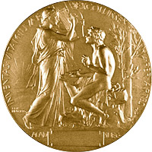
Wit and Wisdom for $300
Which Nobel Prize did Churchill win?
What is Literature?

Slide 12
Wit and Wisdom for $400
What was Churchill referring to when he said on November 10, 1942,
“We have victory – a remarkable and definite victory.”?
What is the victory of the 8th Army at Alamein?

Slide 13
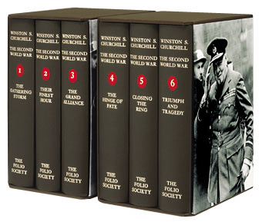
Wit and Wisdom for $500
‘How the English-speaking peoples, through their unwisdom, carelessness, and good nature, allowed the wicked to realm’ is the theme of which volume of The Second World War?
What is The Gathering Storm?

Slide 14
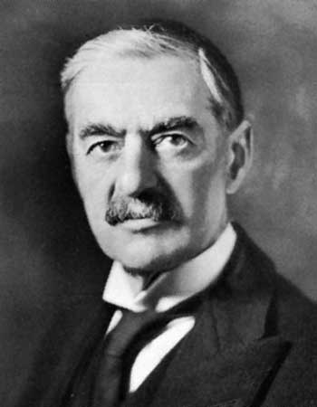
Leadership for $100
Whom did Churchill replace as Prime Minister in 1940?
Who is Neville Chamberlain?

Slide 15
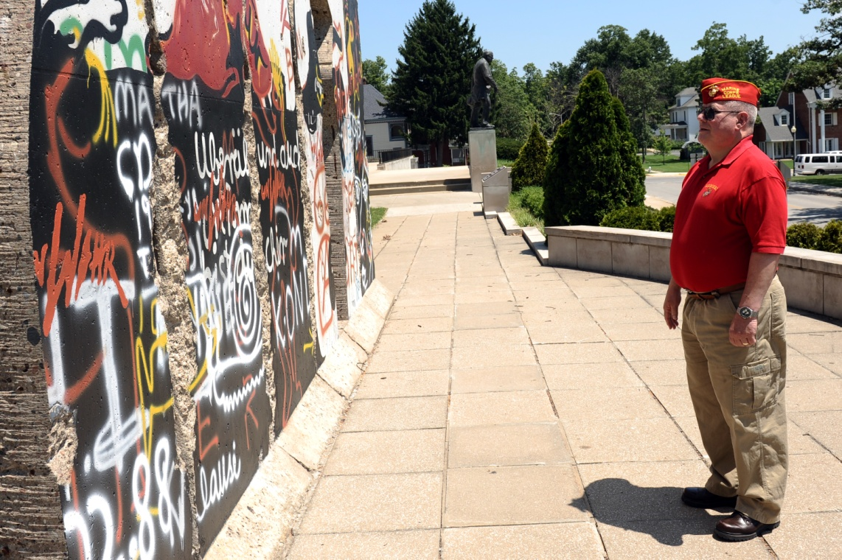
Leadership for $200
Which country did Churchill call ‘The Great Republic’?
What is America?

Slide 16
Leadership for $300
Which country was Churchill referring to when he said in 1939, “throwing a small state to the wolves would not appease the Nazis”?
What is Czechoslovakia?

Slide 17
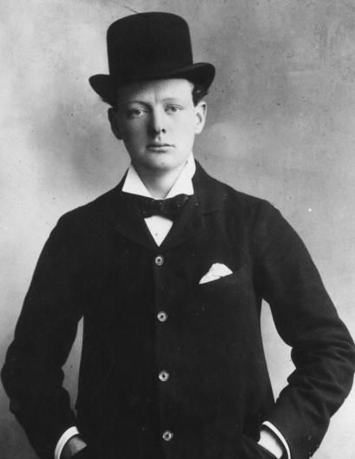
Leadership for $400
For how many years was Churchill a Member of Parliament?
What is 62 years?
1904: Conservative Member of Parliament for Oldham

Slide 18
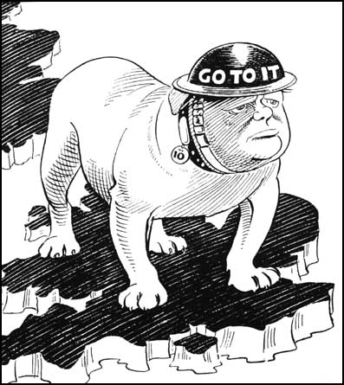
Leadership for $500
Why did cartoonists use the bulldog to symbolize Churchill?
What is Churchill’s aggressiveness and fighting spirit?

Slide 19
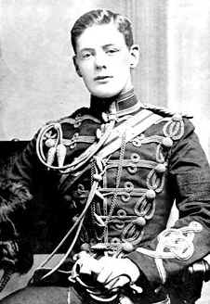
Life and Times for $100
This photograph of an assured Winston Churchill was taken when we was 30 years old.
In which year was it taken?
What is 1905?

Slide 20
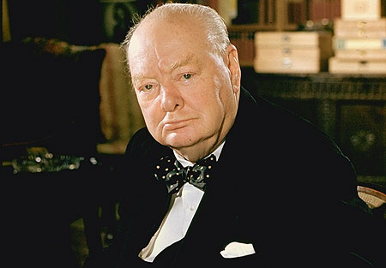
Life and Times for $200
In which year did Winston Churchill die?
What is 1965?

Slide 21
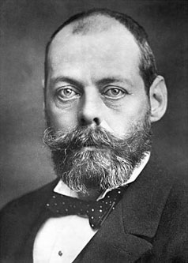
Life and Times for $300
“I never saw him again, except as a swiftly fading shadow.”
Whom was Winston Churchill writing about in June 1894?
Who is Churchill’s father, Lord Randolph Churchill?

Slide 22
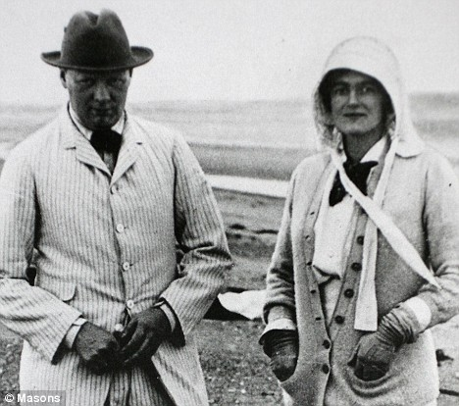
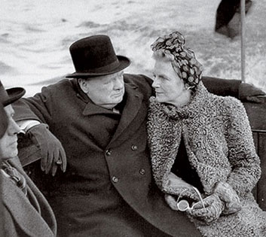
Life and Times for $400
His long marriage to Clementine Hozier was a happy one.
For how many years were they married?
What is 56 years?

Slide 23
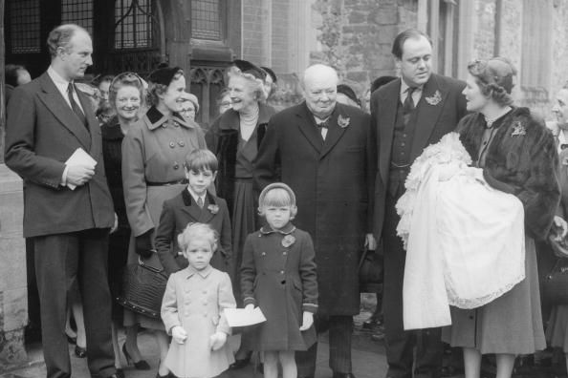
Life and Times for $500
What are the names of Churchill and Clementine’s children?
Who are Diana, Randolph, Sarah, Marigold, and Mary?

Slide 24
Fun Facts for $100
What distinction did Winston Churchill receive in 1948 from the Royal Academy of Arts?
What is Honorary Academician Extraordinary?

Slide 25
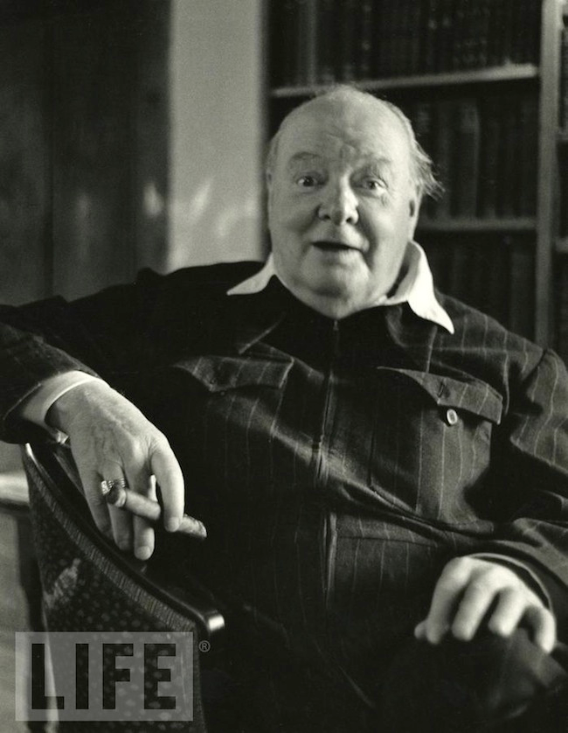
Fun Facts for $200
What two hobbies did Churchill take up while in Cuba?
What are cigar smoking and siestas?

Slide 26
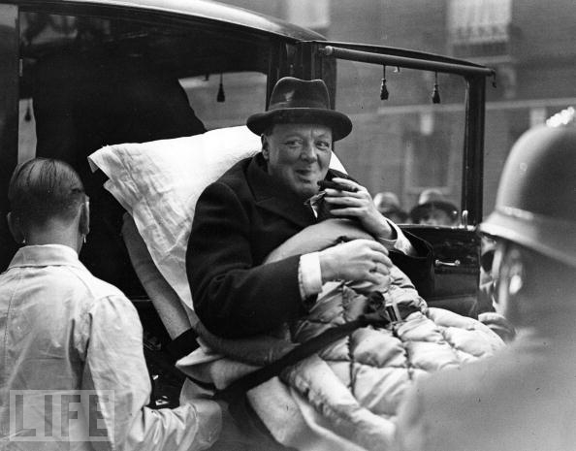
Fun Facts for $300
What life-changing event occurred in 1931 while Churchill visited the United States?
What is hit by a car?

Slide 27
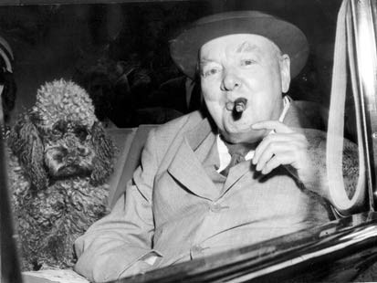
Fun Facts for $400
Churchill had a cat during World War II. What was its name?
What is Nelson?
Bonus Question (extra $100 if correct):
Churchill had a variety of animals. At one point, he had a brown poodle.
What was its name?
Rufus

Slide 28
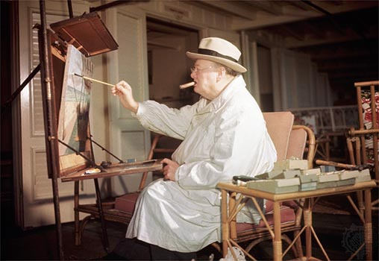
Fun Facts for $500
What two reasons caused Churchill to begin painting?
What is his depression over losing his position at the Admiralty in 1915 and his inability to influence the course of war?

